Slide 1
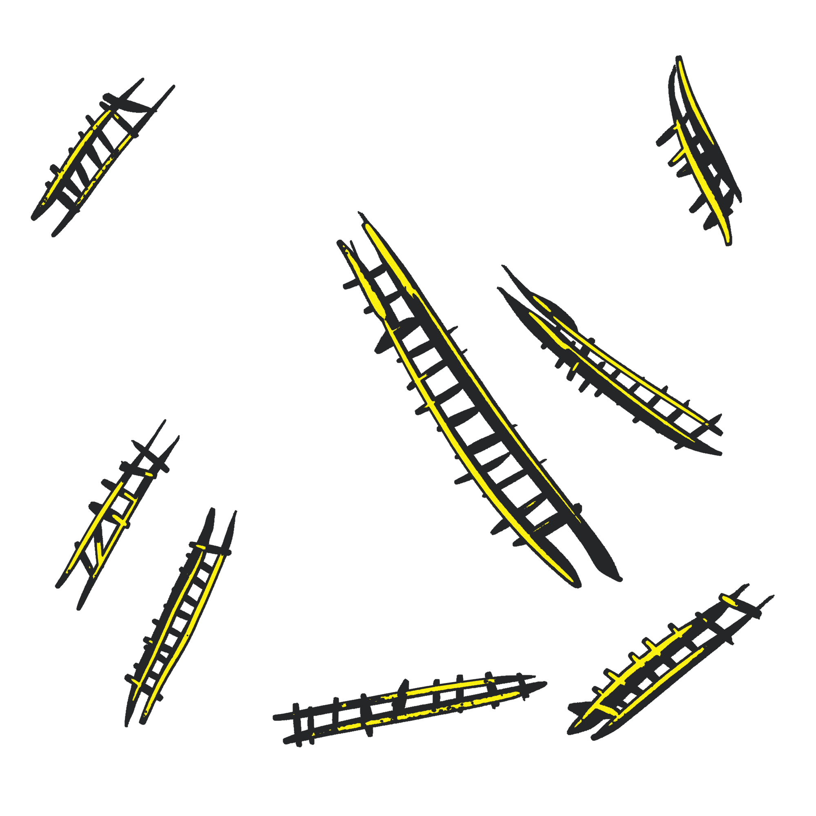
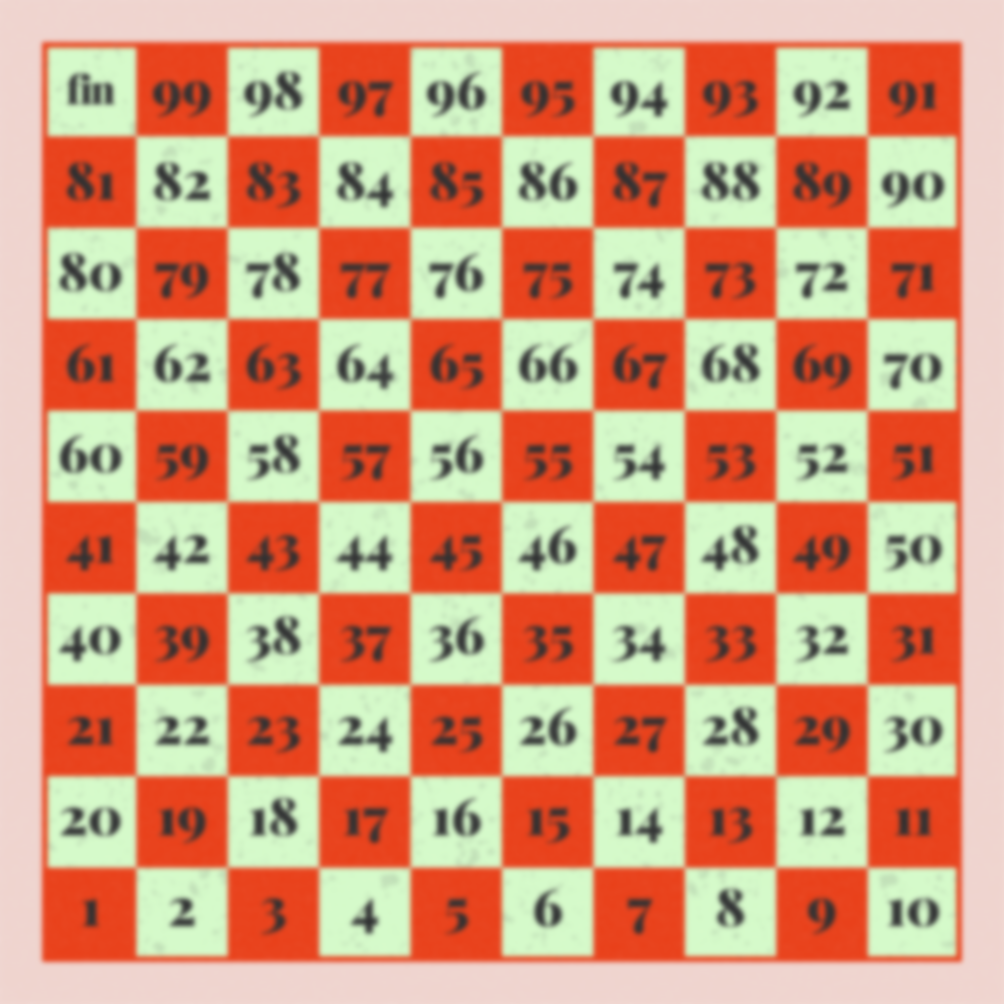
Python Project
Snakes and Ladders Re-imagined

Slide 2
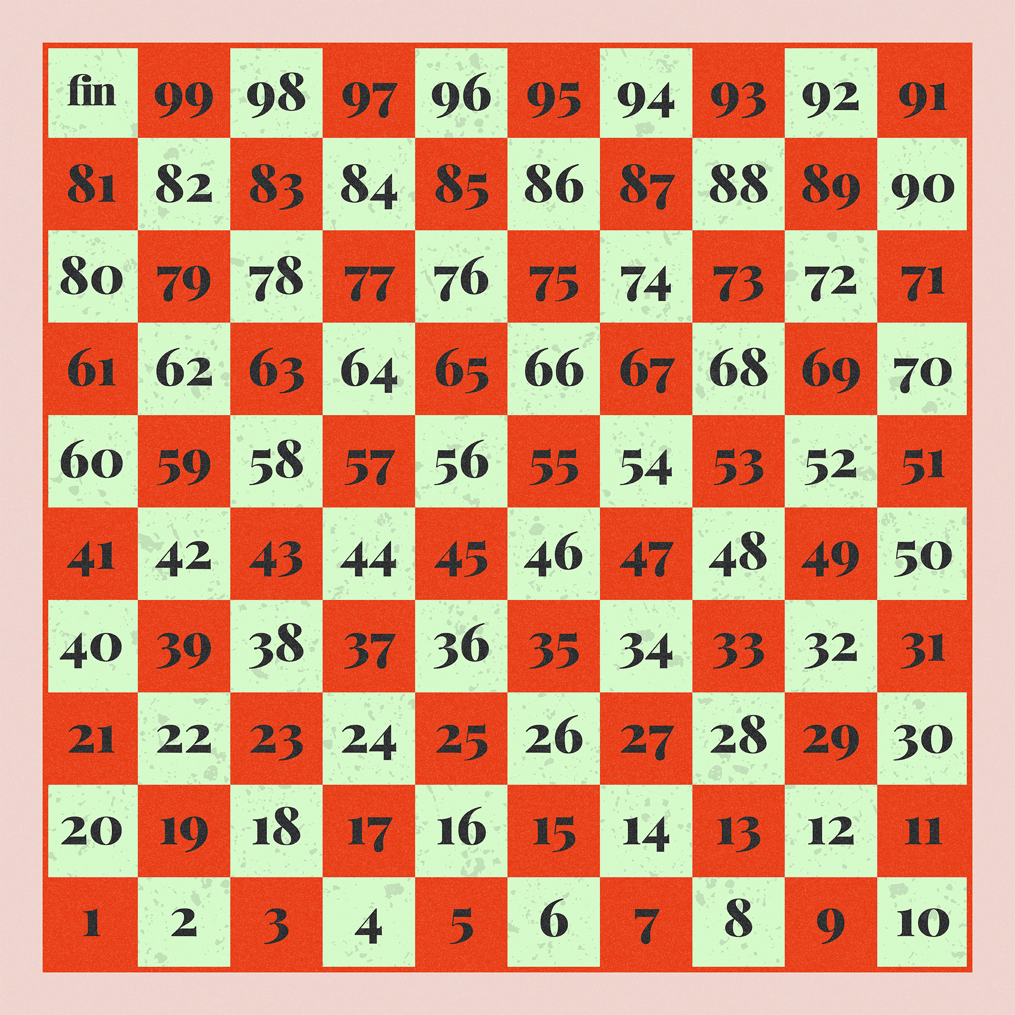
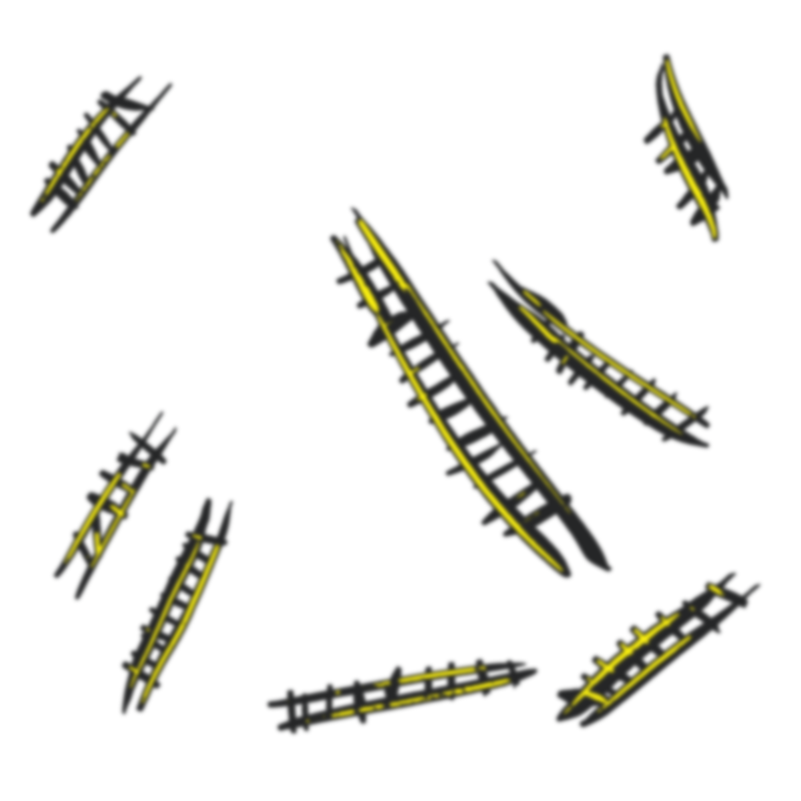
Python Project
Snakes and Ladders Re-imagined
Richa G, Rohan Raghu,
Satvik RK, Thanusha SM

Slide 3
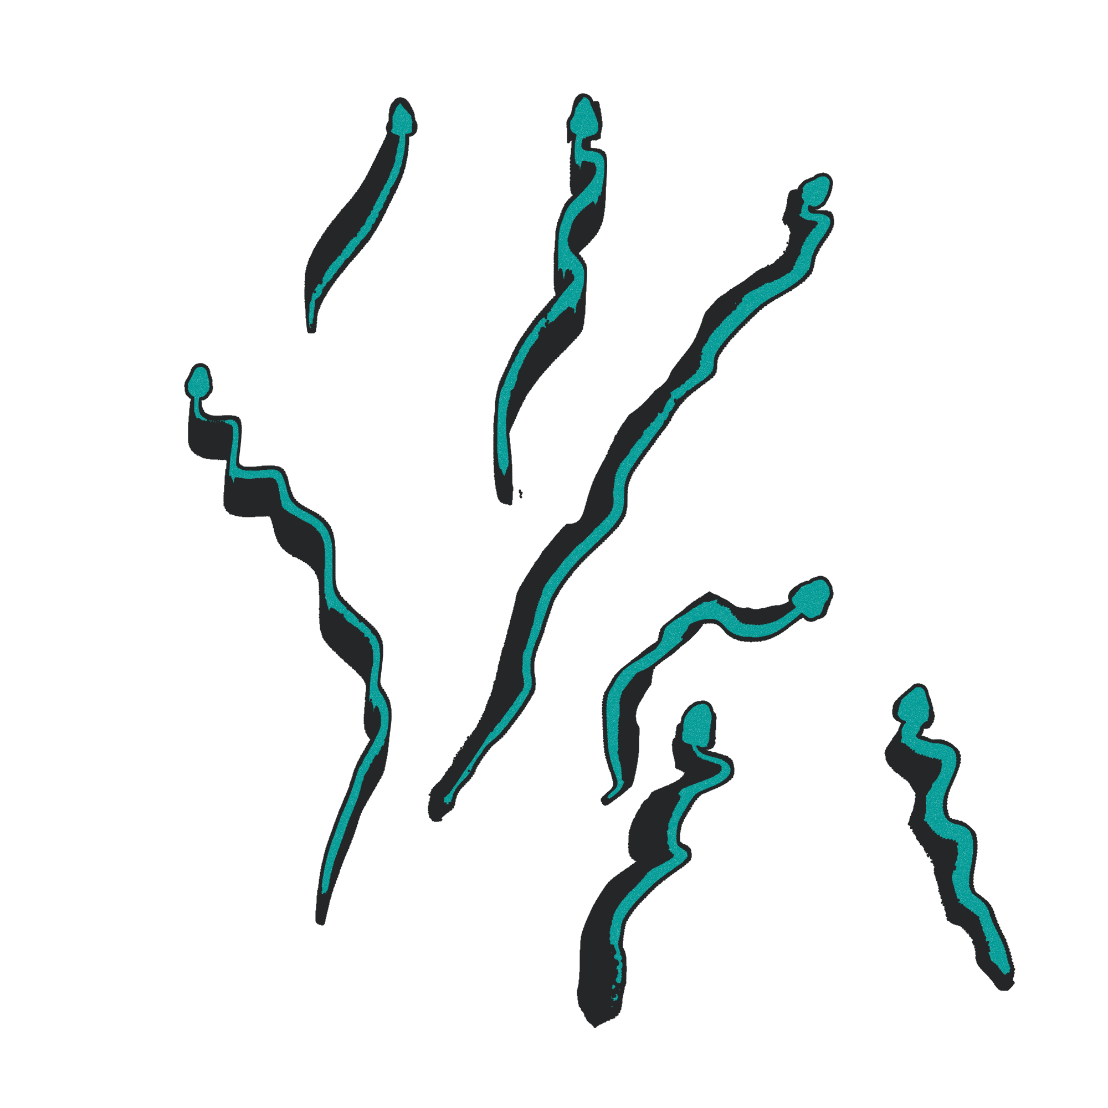
Python Project
Snakes and Ladders Re-imagined
Richa G, Rohan Raghu,
Satvik RK, Thanusha SM

Slide 4
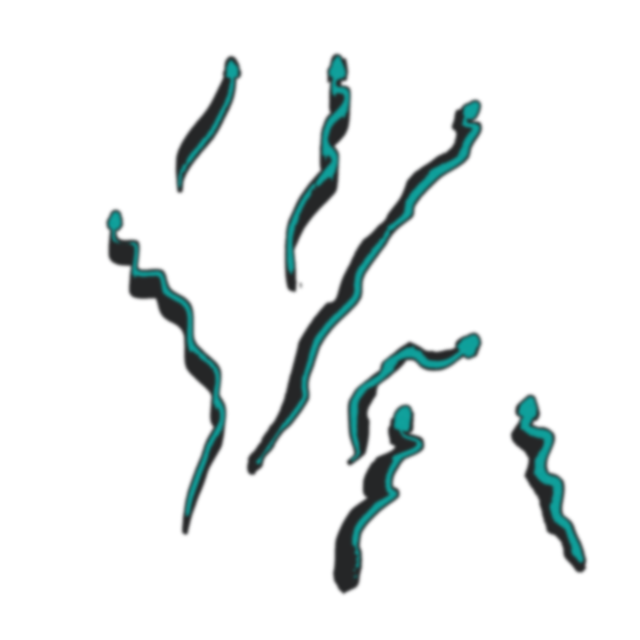
Python Project
Our Goal
Snakes and Ladders Re-imagined
Richa G, Rohan Raghu,
Satvik RK, Thanusha SM
As a team we want to change the traditional way of the old snakes and ladders and make it more interesting and fun to play.
We want this game to involve the player completely in the game rather than just rolling the dice and moving the pawns.

Slide 5
Our Goal
As a team we want to change the traditional way of the old snakes and ladders and make it more interesting and fun to play.
We want this game to involve the player completely in the game rather than just rolling the dice and moving the pawns.

Slide 6
Our Goal
Working of the Game
Richa G, Rohan Raghu,
Satvik RK, Thanusha SM
We start the game by rolling the die and moving our pawns up the virtual board.
If a player lands on a snake he/she gets a riddle and if the player fails to answer the riddle they will be sent a few positions behind and if they get it right they stay in the current position.
If the player lands in the ladder he/she gets a riddle and if they answer they move ahead in the board else they stay in the current position.
The player who manages to reach the end in the lowest time wins.

Slide 7
Working of the Game
We start the game by rolling the die and moving our pawns up the virtual board.
If a player lands on a snake he/she gets a riddle and if the player fails to answer the riddle they will be sent a few positions behind and if they get it right they stay in the current position.
If the player lands in the ladder he/she gets a riddle and if they answer they move ahead in the board else they stay in the current position.
The player who manages to reach the end in the lowest time wins.

Slide 8
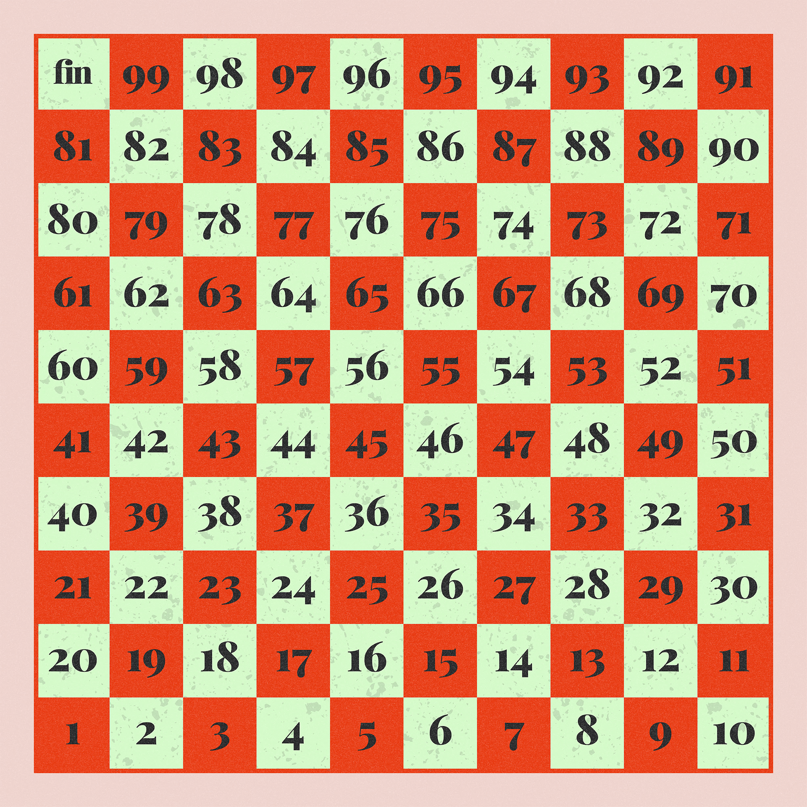
Working of the Game
We start the game by rolling the die and moving our pawns up the virtual board.
If a player lands on a snake he/she gets a riddle and if the player fails to answer the riddle they will be sent a few positions behind and if they get it right they stay in the current position.
If the player lands in the ladder he/she gets a riddle and if they answer they move ahead in the board else they stay in the current position.
The player who manages to reach the end in the lowest time wins.
The Board

Slide 9
Working of the Game
We start the game by rolling the die and moving our pawns up the virtual board.
If a player lands on a snake he/she gets a riddle and if the player fails to answer the riddle they will be sent a few positions behind and if they get it right they stay in the current position.
If the player lands in the ladder he/she gets a riddle and if they answer they move ahead in the board else they stay in the current position.
The player who manages to reach the end in the lowest time wins.
The Board

Slide 10
Working of the Game
The Code
import random
pos=1
score=0
ladders = {2: 38, 4: 14, 8: 30, 21: 42, 28: 76, 50: 67, 71: 92, 80: 99}
snakes = {32: 10, 34: 6, 48: 26, 62: 18, 88: 24, 95: 56, 97: 78}
def diceroll():
opt=input("Do you wish to roll the dice? (y/n): ")
if opt=="y":
return True
else:
return False
def board(pos):
print(" ----------------------------------------------------------- ")
for i in range (10, 0, -1):
print("|" , end="")
for j in range(10*i, (10*i) - 10, -1):
if j==pos:
print(" ", "•", end=" |")
elif j==100:
print("", j, end=" |")
elif j>9 and j<100: print(" ", j, end=" |")
elif j>0 and j<10:
print(" ", j, end=" |")
print("")
print(" ----------------------------------------------------------- ")
board(pos)
while pos<100:
if diceroll():
pos+=random.randint(1,6)
print("\nYour position is", pos)
if pos in snakes:
print("You have been bitten by a snake!")
pos=snakes[pos]
print("\nYour position is", pos)
elif pos in ladders:
print("You have climbed up a ladder!")
pos=ladders[pos]
print("\nYour position is", pos)
board(pos)
if pos>=100:
print("You win!")

Slide 11
Working of the Game
The Code
import random
pos=1
score=0
ladders = {2: 38, 4: 14, 8: 30, 21: 42, 28: 76, 50: 67, 71: 92, 80: 99}
snakes = {32: 10, 34: 6, 48: 26, 62: 18, 88: 24, 95: 56, 97: 78}
def diceroll():
opt=input("Do you wish to roll the dice? (y/n): ")
if opt=="y":
return True
else:
return False
def board(pos):
print(" ----------------------------------------------------------- ")
for i in range (10, 0, -1):
print("|" , end="")
for j in range(10*i, (10*i) - 10, -1):
if j==pos:
print(" ", "•", end=" |")
elif j==100:
print("", j, end=" |")
elif j>9 and j<100: print(" ", j, end=" |")
elif j>0 and j<10:
print(" ", j, end=" |")
print("")
print(" ----------------------------------------------------------- ")
board(pos)
while pos<100:
if diceroll():
pos+=random.randint(1,6)
print("\nYour position is", pos)
if pos in snakes:
print("You have been bitten by a snake!")
pos=snakes[pos]
print("\nYour position is", pos)
elif pos in ladders:
print("You have climbed up a ladder!")
pos=ladders[pos]
print("\nYour position is", pos)
board(pos)
if pos>=100:
print("You win!")
import tkinter as tk
from PIL import ImageTk, Image
root=tk.Tk()
root.geometry("1920x1080")
root.title("Snakes & Ladders")
F1=tk.Frame(root, width=1000, height=1000, relief='raised')
F1.place(x=0, y=0)
bg=Image.open("finalboard.png")
resized_bg= bg.resize((1000,1000), Image.LANCZOS)
new_bg= ImageTk.PhotoImage(resized_bg)
bglbl=tk.Label(F1, image=new_bg)
bglbl.place(x=0, y=0)
b1=tk.Button(root, text="Rules", height=3, width=20, fg="#BABABA", bg="#EEEEEE", font=("Poppins", "14", "bold"), relief="flat")
b1.place(x=1200, y=400)

Slide 12
Working of the Game
import random
pos=1
score=0
ladders = {2: 38, 4: 14, 8: 30, 21: 42, 28: 76, 50: 67, 71: 92, 80: 99}
snakes = {32: 10, 34: 6, 48: 26, 62: 18, 88: 24, 95: 56, 97: 78}
def diceroll():
opt=input("Do you wish to roll the dice? (y/n): ")
if opt=="y":
return True
else:
return False
def board(pos):
print(" ----------------------------------------------------------- ")
for i in range (10, 0, -1):
print("|" , end="")
for j in range(10*i, (10*i) - 10, -1):
if j==pos:
print(" ", "•", end=" |")
elif j==100:
print("", j, end=" |")
elif j>9 and j<100: print(" ", j, end=" |")
elif j>0 and j<10:
print(" ", j, end=" |")
print("")
print(" ----------------------------------------------------------- ")
board(pos)
while pos<100:
if diceroll():
pos+=random.randint(1,6)
print("\nYour position is", pos)
if pos in snakes:
print("You have been bitten by a snake!")
pos=snakes[pos]
print("\nYour position is", pos)
elif pos in ladders:
print("You have climbed up a ladder!")
pos=ladders[pos]
print("\nYour position is", pos)
board(pos)
if pos>=100:
print("You win!")
import tkinter as tk
from PIL import ImageTk, Image
root=tk.Tk()
root.geometry("1920x1080")
root.title("Snakes & Ladders")
F1=tk.Frame(root, width=1000, height=1000, relief='raised')
F1.place(x=0, y=0)
bg=Image.open("finalboard.png")
resized_bg= bg.resize((1000,1000), Image.LANCZOS)
new_bg= ImageTk.PhotoImage(resized_bg)
bglbl=tk.Label(F1, image=new_bg)
bglbl.place(x=0, y=0)
b1=tk.Button(root, text="Rules", height=3, width=20, fg="#BABABA", bg="#EEEEEE", font=("Poppins", "14", "bold"), relief="flat")
b1.place(x=1200, y=400)
The Code

Slide 13
import random
pos=1
score=0
ladders = {2: 38, 4: 14, 8: 30, 21: 42, 28: 76, 50: 67, 71: 92, 80: 99}
snakes = {32: 10, 34: 6, 48: 26, 62: 18, 88: 24, 95: 56, 97: 78}
def diceroll():
opt=input("Do you wish to roll the dice? (y/n): ")
if opt=="y":
return True
else:
return False
def board(pos):
print(" ----------------------------------------------------------- ")
for i in range (10, 0, -1):
print("|" , end="")
for j in range(10*i, (10*i) - 10, -1):
if j==pos:
print(" ", "•", end=" |")
elif j==100:
print("", j, end=" |")
elif j>9 and j<100: print(" ", j, end=" |")
elif j>0 and j<10:
print(" ", j, end=" |")
print("")
print(" ----------------------------------------------------------- ")
board(pos)
while pos<100:
if diceroll():
pos+=random.randint(1,6)
print("\nYour position is", pos)
if pos in snakes:
print("You have been bitten by a snake!")
pos=snakes[pos]
print("\nYour position is", pos)
elif pos in ladders:
print("You have climbed up a ladder!")
pos=ladders[pos]
print("\nYour position is", pos)
board(pos)
if pos>=100:
print("You win!")
import tkinter as tk
from PIL import ImageTk, Image
root=tk.Tk()
root.geometry("1920x1080")
root.title("Snakes & Ladders")
F1=tk.Frame(root, width=1000, height=1000, relief='raised')
F1.place(x=0, y=0)
bg=Image.open("finalboard.png")
resized_bg= bg.resize((1000,1000), Image.LANCZOS)
new_bg= ImageTk.PhotoImage(resized_bg)
bglbl=tk.Label(F1, image=new_bg)
bglbl.place(x=0, y=0)
b1=tk.Button(root, text="Rules", height=3, width=20, fg="#BABABA", bg="#EEEEEE", font=("Poppins", "14", "bold"), relief="flat")
b1.place(x=1200, y=400)
Working of the Game
The Code

Slide 14
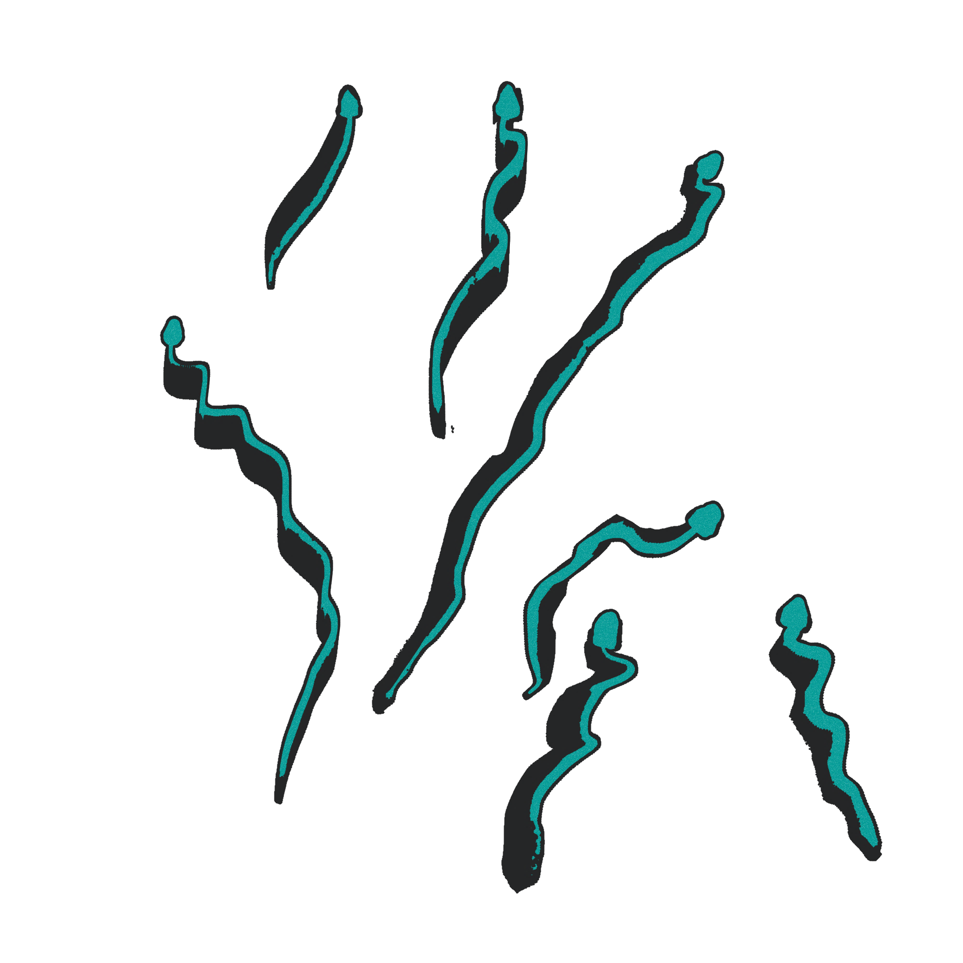
Python Project
The End
Snakes and Ladders Re-imagined
Richa G, Rohan Raghu,
Satvik RK, Thanusha SM
As a team we want to change the traditional way of the old snakes and ladders and make it more interesting and fun to play.
We want this game to involve the player completely in the game rather than just rolling the dice and moving the pawns.

